Slide 1
Project Timeline
W41
W42
W43
W44
W45
W46
W47
W48
(oct 13~19)
(oct 20~26)
(oct 27~Nov 2)
(Nov 3~9)
(Nov 10~16)
(Nov 17~23)
(Nov 24~30)
(Dec 1~5)
Review
Previous Research
Devansh
Dinisha
Jongbum
Processe & Analysis
DB
Tanvir
Evie
Design Init Model
& Coding for Training
Jongbum
Dinisha
Evie
Devansh
Refinement & Preprocessing
Evie
Tanvir
Additional
Feature
Tanvir
Devansh
Dinisha
Analysis
Init Model Result
Jongbum
Evie
Tanvir
Opti. Model Accuracy
Jongbum
Evie
Tanvir
Final Report
1st
Report
Final
Model

Slide 2
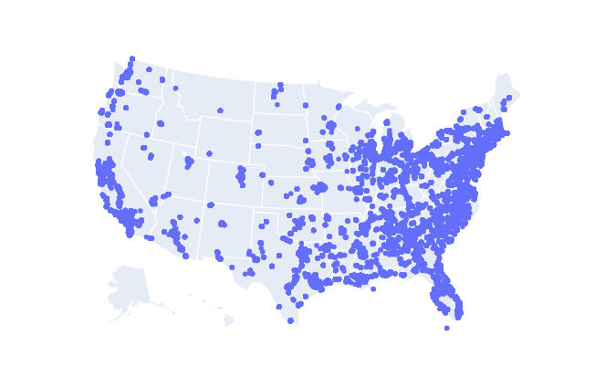
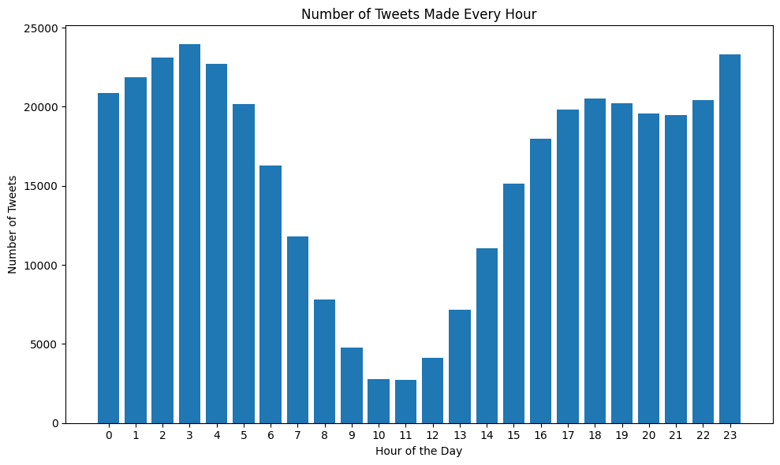

Predict Geolocation based on Social Media Text
Fall 2024 – AI Practicum
Social Media Data
Solution Design
Statistical DB analysis
Geographical, Tweet Time Distribution
Noise and Outlier analysis & Cleaning
Remove Emoji, punctuations
Word Lemmatization
Non-US DB Translation
Pipeline of Two Cascading Models
1st Model: TD-IDF and Linear SVC
2nd Model: Predict Location
< Geographical Analysis>
< Tweet time Analysis>
It’s decided. Getting a tattoo.

Slide 3
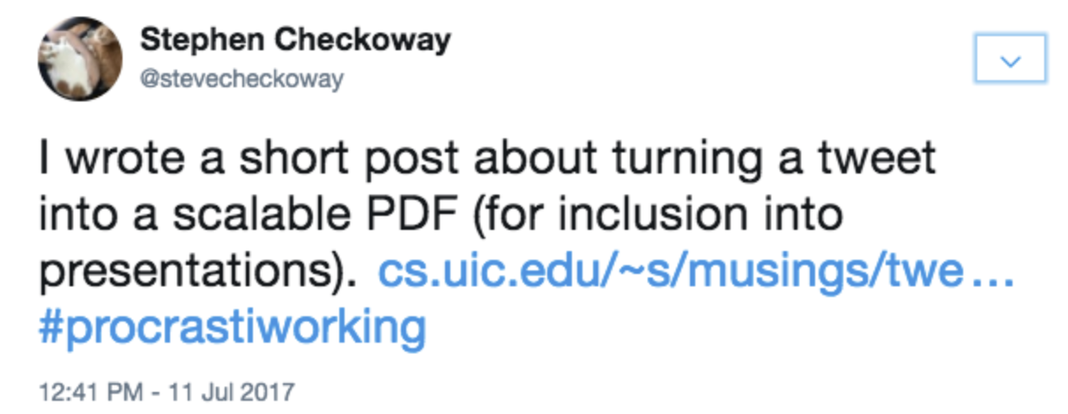
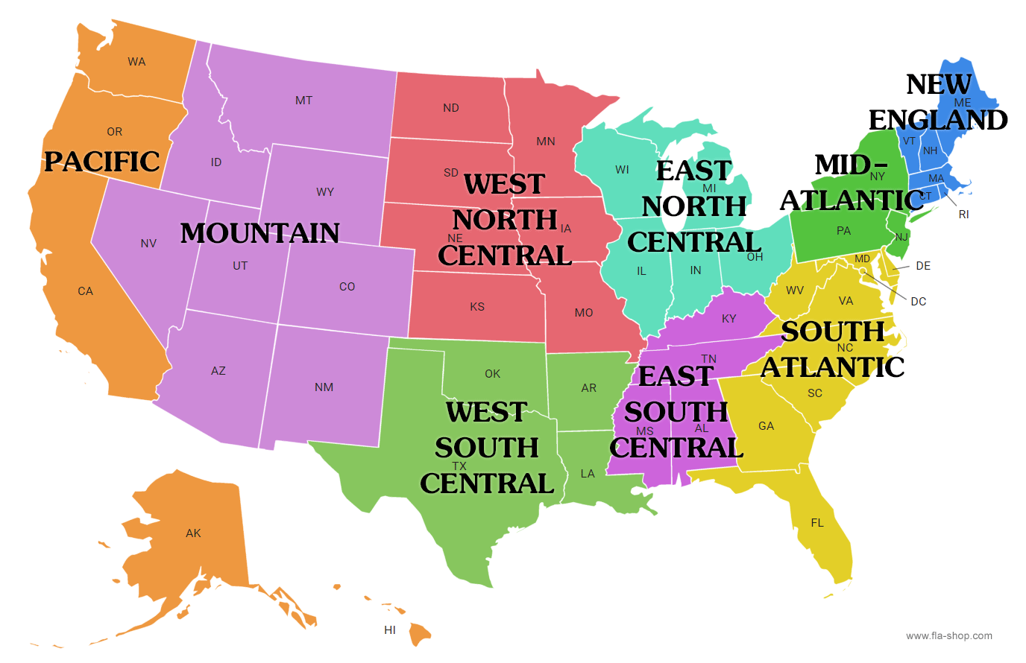
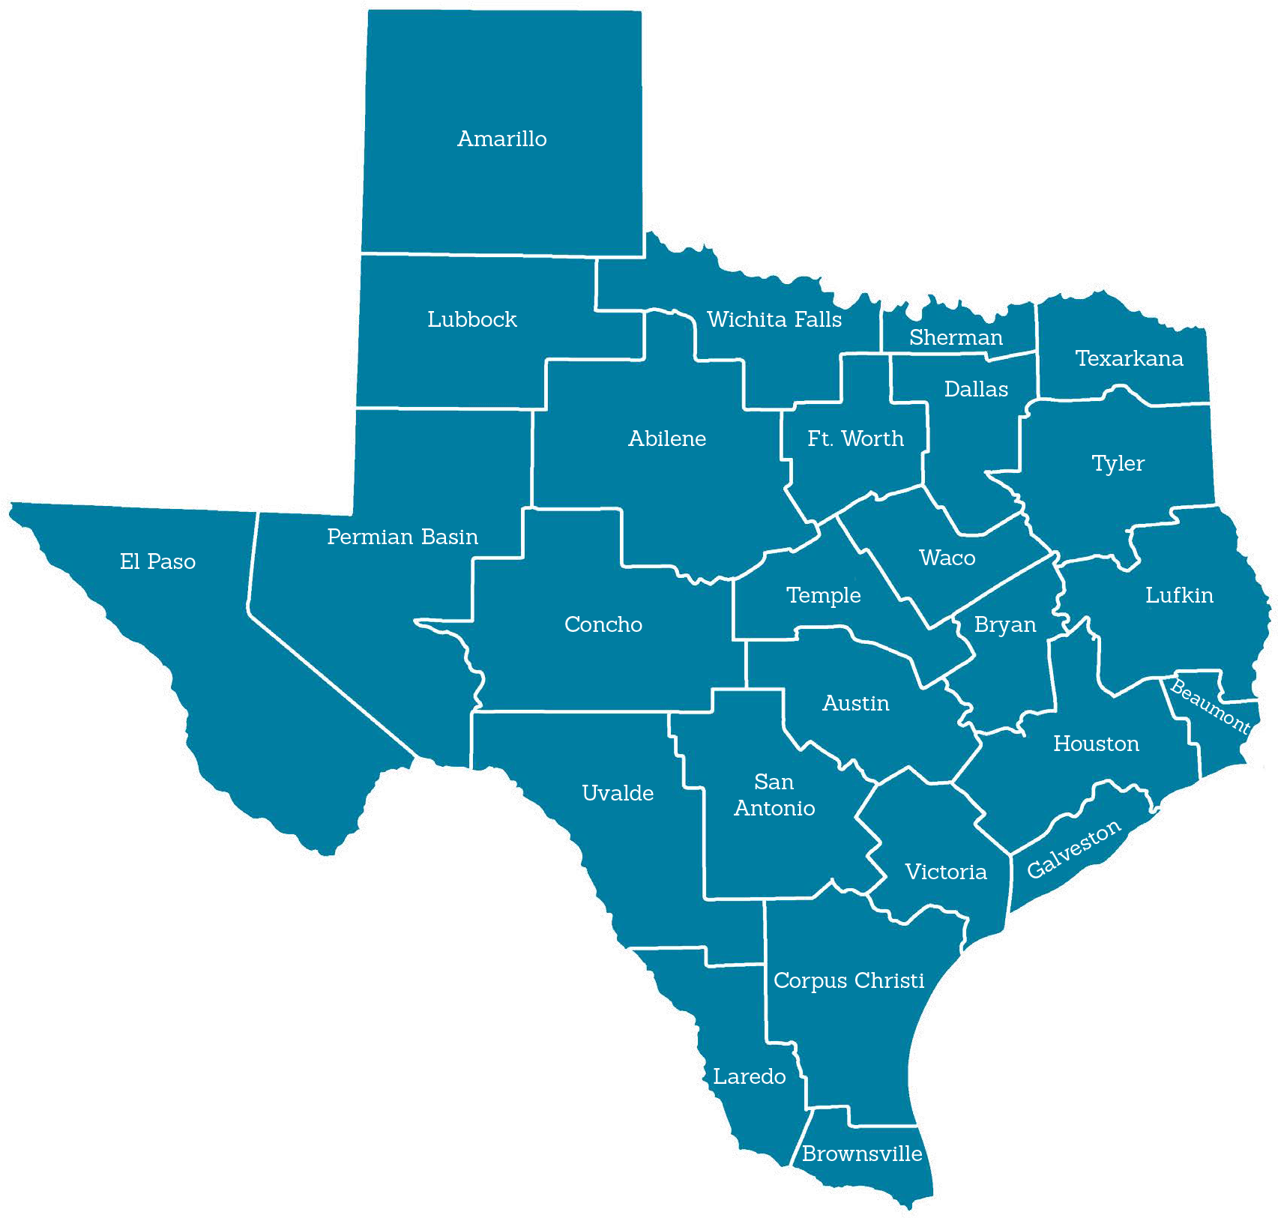
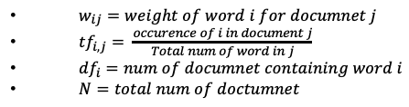
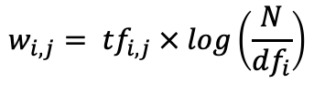
Model Design & Training – Region and States
Fall 2024 – AI Practicum
Vectorization: TF-IDF (Term Frequency-Inverse Document Frequency)
Classification: Two Linear SVC Model (Region and State)
TF-IDF Machine Learning Model
Statistical formula to Convert text doc into vectors
Linear SVC (Support Vector Classifier)
1st Model: Text → 9 Regions
2nd Model: 9 Regions → State
$$w_{i,j}= {tf}_{i,j} × log\left(\frac{N}{{df}_{i}}\right)$$
$w_{ij}=weight of word i for documnet j$
${tf}_{i,j}= \frac{occurence of i in document j}{Total num of word in j}$
${df}_{i}=num of documnet containing word i$
$N=total num of doctumnet$
TF-IDF
Vectoriztion
1st Linear SVC
< 1st SVC Result: Region>
< 2nd SVC Result: State >
Classification
Region
Test Result
Precision: 98%, Recall: 98% f1-score: 98%
Extract Common Words by Region
2nd Linear SVC
Region | Common words
Mountain | asu | phx | arizona | kubball
NW Central | geeksquad | hum | sherroncollins | kubball
SW Central | texas | dallas | sse | houston
State

Slide 4
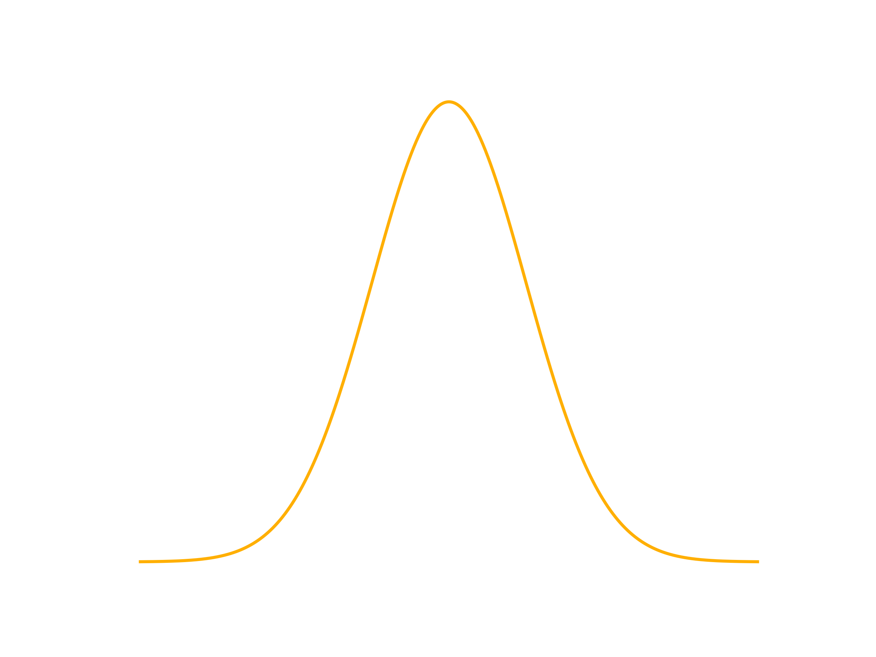
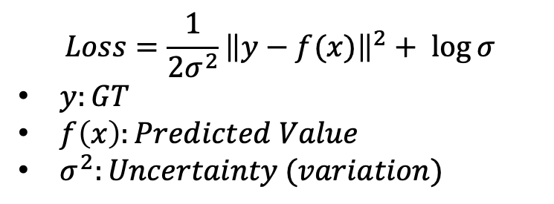
Model Design & Training – Location Model
Fall 2024 – AI Practicum
Foundation Model: Simplified BERT Model (HuggingFace)
Location Model: Convert Vector to Location with Uncertainty
Model Output: Mean & Uncertainty(Variation)¹ of Location
+ State Info
$$Loss=\frac{1}{2σ^{2}}{\left\|y−f(x)\right\|}^{2}+ \log{σ}$$
$y:GT$
$f\left(x\right):Predicted Value$
$σ^{2}:Uncertainty (variation)$
Tokenizer
𝜎²
Foundation Model
BERT
Model
Mean
(Latitude, Longitude)
(Batch, 768)
Test Result
Avg Error: 168.42 km
High Variation Avg Error: 401.66 km
(e.g “I don’t feel so good today!”, ”I am home now.”)
Low Variation Avg Error: 34.88km
(e.g “I am in the river walk”, “New york, New york!!”)
High Variation
Our Model
Location
Model
Low Variation
(Mean, Variation)
of Location
¹Multi-Task Learning Using Uncertainty to Weigh Losses for Scene Geometry and Semantics

Slide 5
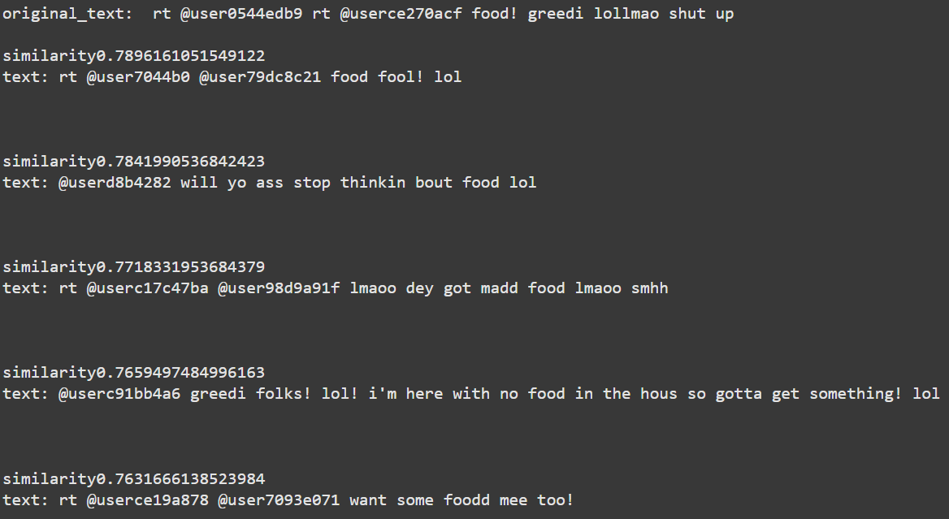
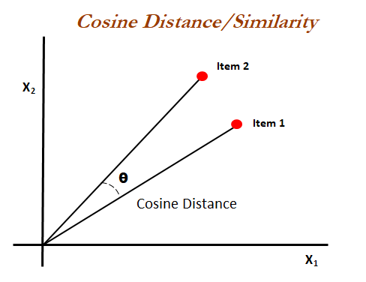
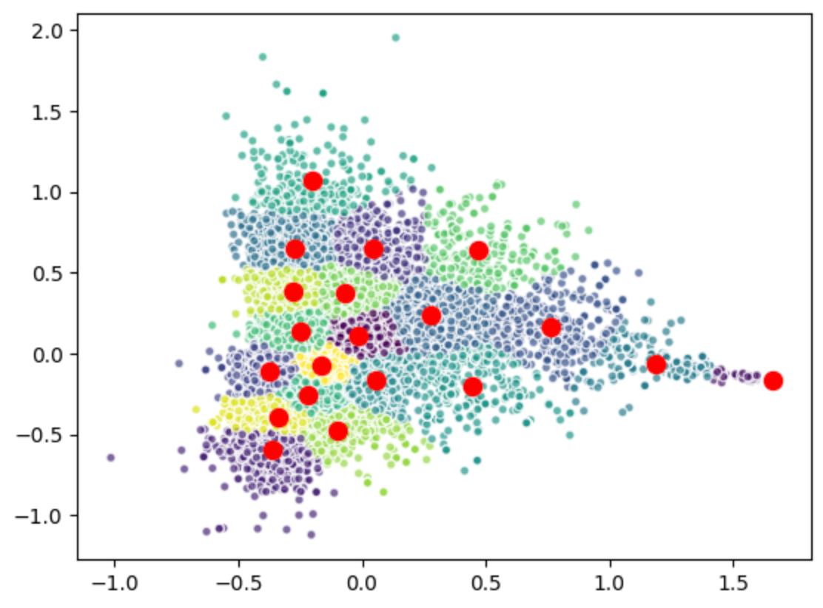
Additional Feature – Recommendation
Fall 2024 – AI Practicum
Vectorized tweet(text) Clustering
Generate sentence embeddings by using pre-trained BERT model
Sentence Embedding with Cosine Distance
Find the cosine distance with the other users post and recommend top 5 related posts
BERT Model

Slide 6
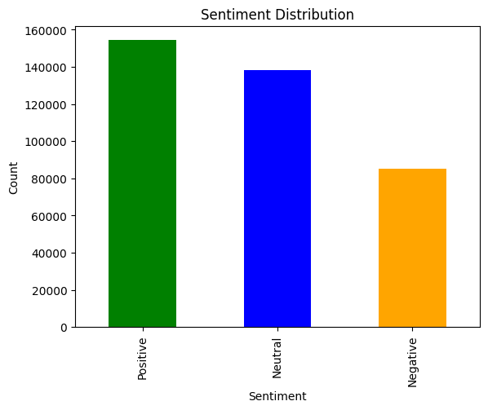
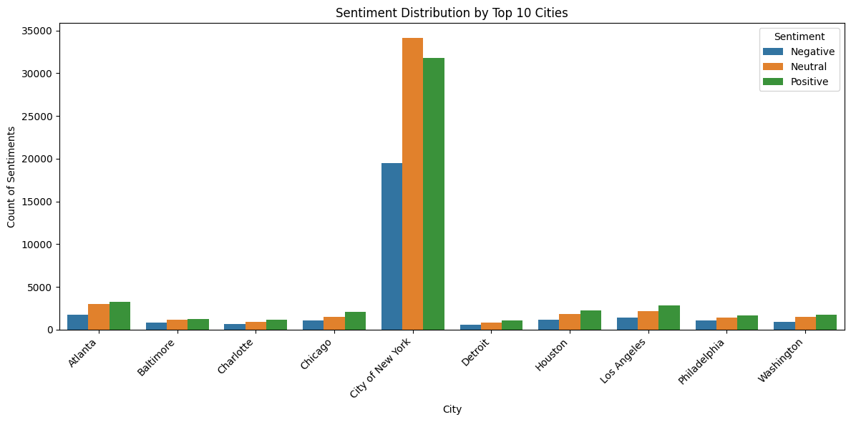
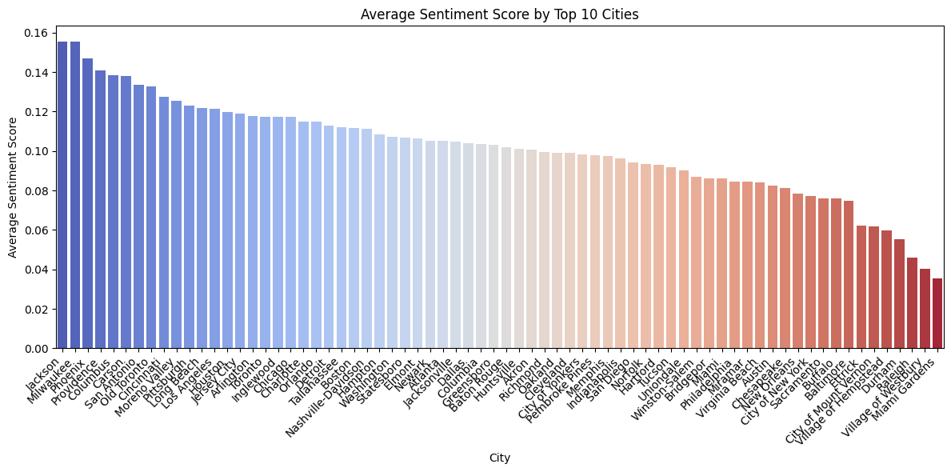
Additional Feature – Sentiment Analysis
Fall 2024 – AI Practicum
Foundation Model: VADER-Sentiment-Analysis
Tokenizer
< Sentiment Distribution >
VADER
Model
(Batch, 3)
'neg': Negative sentiment score
'neu': Neutral sentiment score
'pos': Positive sentiment score
< Sentiment Distribution: Top 10 Cities >
< Avg Sentiment Score: Top 10 Cities >
Conclusion : VADER works well for short texts, while BERT is better for longer texts with more context.

Slide 7
Conclusion
Fall 2024 – AI Practicum
ProProcessing
Provide valuable insights
Cleaning is Related model performance.
Model
Machin Learning Model is good option for Text Classification
BERT Model: Provides vector information applicable to various applications.
(e.g., Geolocation Prediction, Sentiment and Recommendation)
Mean and Uncertainty: provide a range of values instead of a single figure for the model.

Slide 8
Appendix

Slide 9
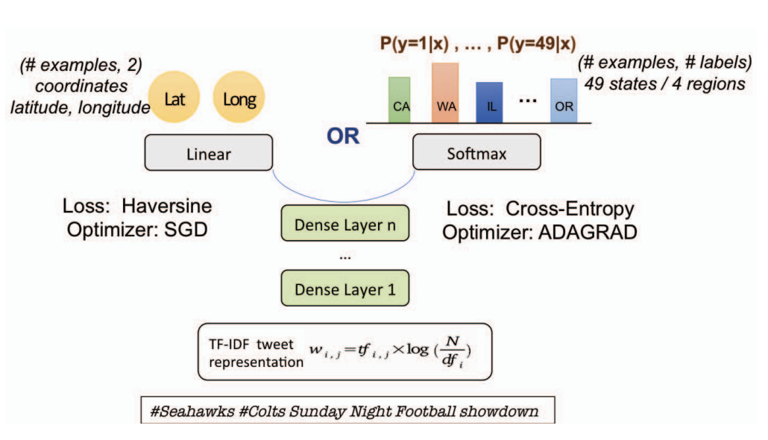
Review Papers - RNN
Fall 2024 – AI Practicum
Text-based Geolocation Prediction of Social Media Users with Neural Network
https://isminoula.github.io/files/geoNN.pdf
TF-IDF for Text Embeding
MLP (Dense Layer)
Cross-Entropy Loss

Slide 10
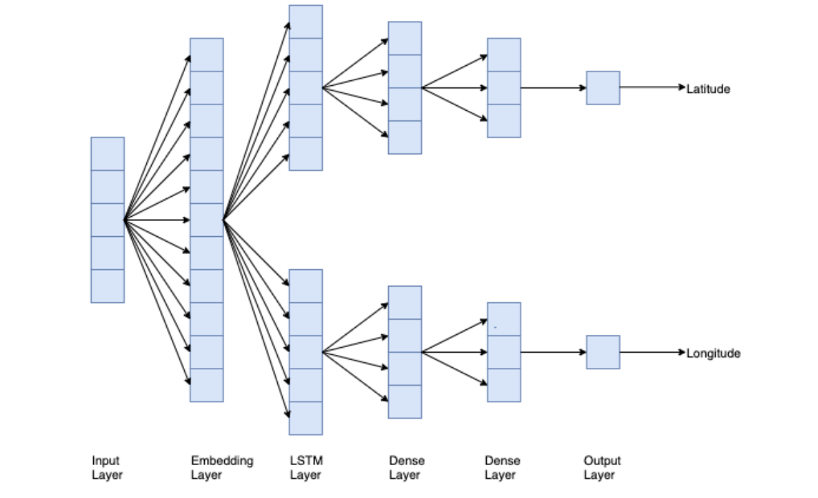
Review Papers – Deep Learning
Fall 2024 – AI Practicum
Geolocation of Tweets with a BiLSTM Regression Model
https://aclanthology.org/2020.vardial-1.27.pdf
Bidirectional LSTM
FastText Embeding (Subword)
Distance based Loss Function

Slide 11
Review Papers - BERT
Fall 2024 – AI Practicum
HeLju@VarDial 2020
https://aclanthology.org/2020.vardial-1.19.pdf
ML Approach
SVR with the TF-IDF weighted Character n-gram(n=3~6)
DL Approach
Pre-trained BERT
Added FC for geolocation outputs (Longitude, Latitude)

Slide 12
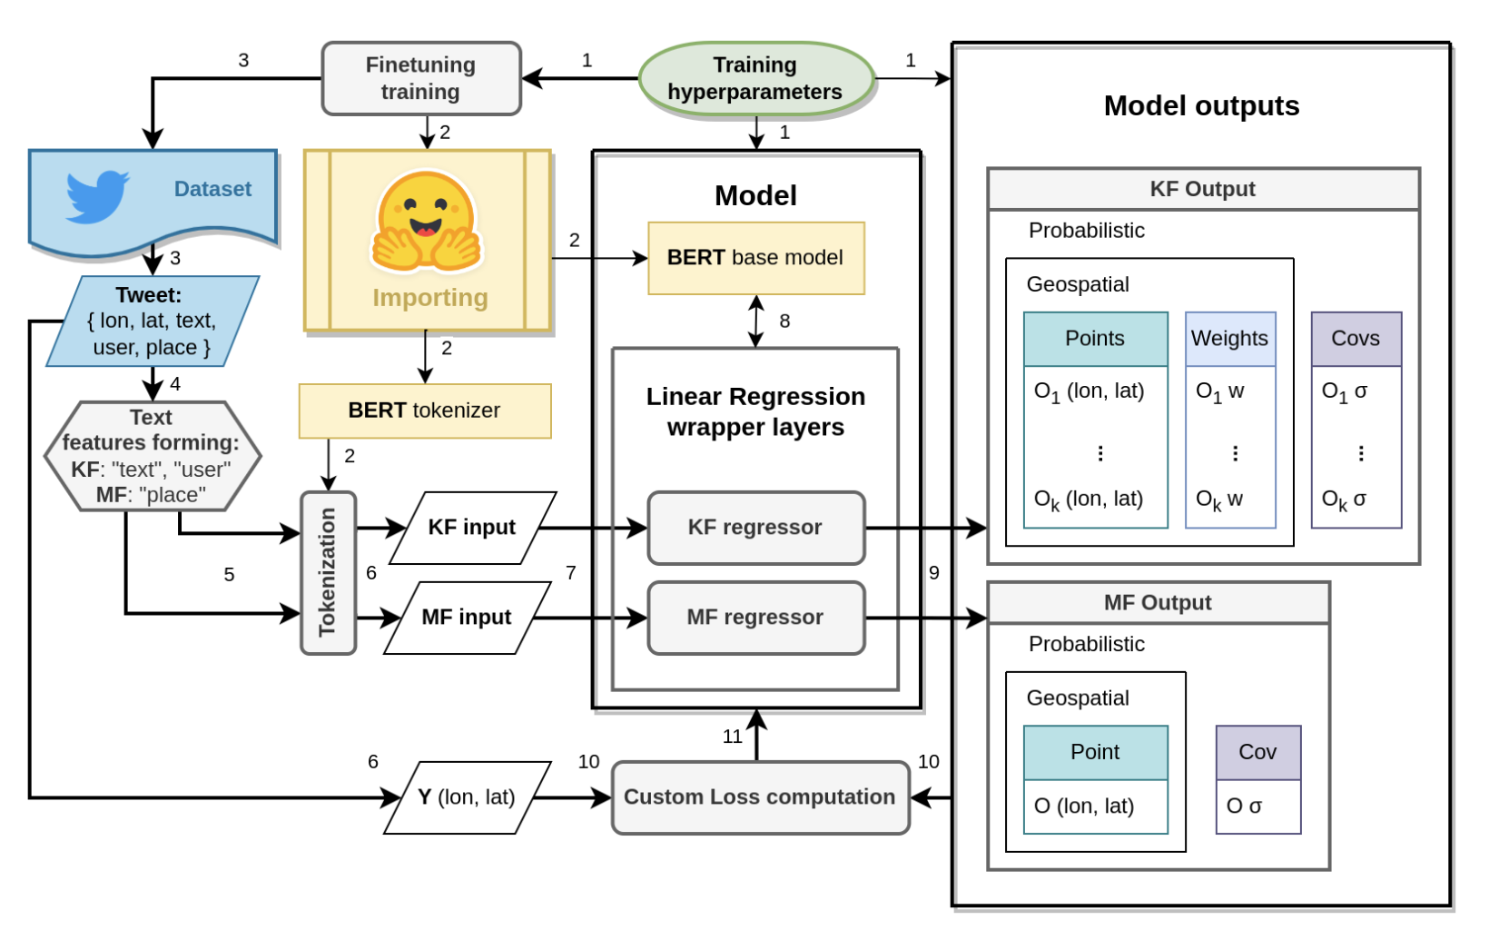
Review Papers - BERT
Fall 2024 – AI Practicum
Predicting the Geolocation of Tweets Using transformer models on Customized Data
https://arxiv.org/html/2303.07865v3
Use Text(Tweet) and Meta (Timestamp, GeoTag, TimeZone, etc)
GMM (Gaussian Mixture Model) based Output.

Slide 13
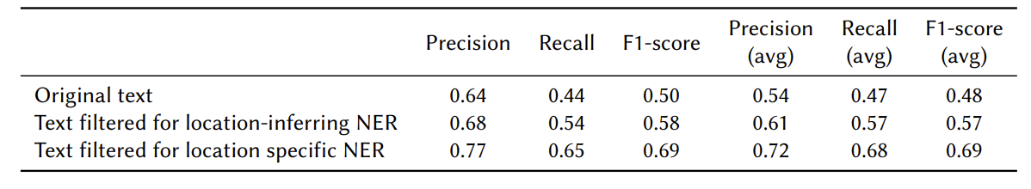
Review Papers - BERT
Fall 2024 – AI Practicum
Geolocation Extraction From Reddit Text Data
https://ceur-ws.org/Vol-3683/paper2.pdf
PreProcessing: NER (Named Entity Recognition)
Geolocation Extraction from location specific Reddit

Slide 14
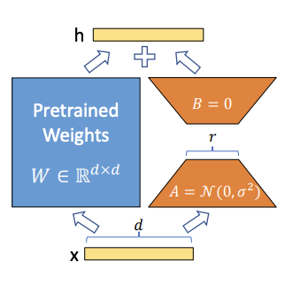
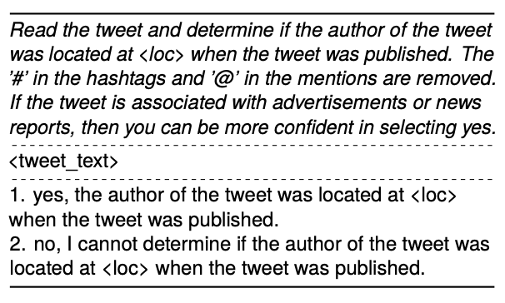
Review Papers - LLM
Fall 2024 – AI Practicum
Analyzing Large Language Models’ Capability in Location Prediction
https://aclanthology.org/2024.lrec-main.85.pdf
LoRa(Low-Rank Adaptation) for Fine-Tuning

Slide 15
Progress Report – Nov 10th
Fall 2024 – AI Practicum
Action Items | Progress
Review Previous Research | Review the papers of location prediction Model
Processing & Analysis DB | Cleaning and Organizing DB Translation Statistic Analysis
Initial Model Design & Training | BERT based Model + Header for Location → Fine-Tuning Predict State, Location (Latitude, Longitude) LLM: Inappropriate for Limited Resources Cluster: Vector Clustering based Location Prediction
Additional Feature | Sentiment Analysis: VADER model, 3 Emotions Recommendation:

Slide 16
Review Previous Research
Fall 2024 – AI Practicum
Machine Learning
TF-IDE + SVR: Accuracy is worse than the Deep Learning based model
Deep Learning Model
RNN
LSTM based Model
CNN+SVM
BERT
Transformer Encoder: Foundation model → Model convert text to Vectorized data
BERT + Additional Layer: Fine-Tuning only Additional Layer.
LLM (GPT, LLMA)
Adopted Transformer Decoder
Fine-Tune with LoRa: require many GPUs.

Slide 17
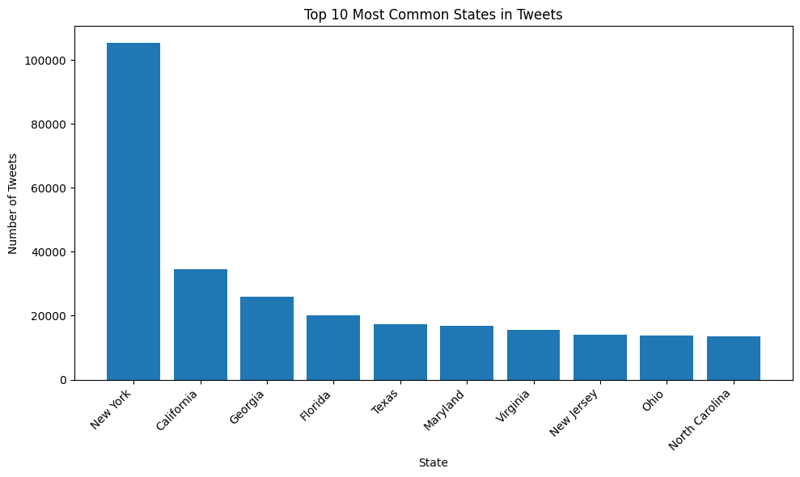
Process & Analysis DB
Fall 2024 – AI Practicum
Data Preprocessing
Analysis DB
Cleaning DB
emojis
Missing text fields
Inaccurate location data
Non-US locations
Translation
Translate Non-English Database Using Google Translator
Statistical Analyses
Geographical Tweet Distribution
Tweet Time Distribution Analysis
Visualize Geographical Distribution
It’s decided. Getting a tattoo.

Slide 18
Review Previous Research
Fall 2024 – AI Practicum
Machine Learning
TF-IDE + SVR: Accuracy is worse than the Deep Learning based model
Deep Learning Model
RNN
LSTM based Model
CNN+SVM
BERT
Transformer Encoder: Foundation model → Model convert text to Vectorized data
BERT + Additional Layer: Fine-Tuning only Additional Layer.
LLM (GPT, LLMA)
Adopted Transformer Decoder
Fine-Tune with LoRa: require many GPUs.

Slide 19
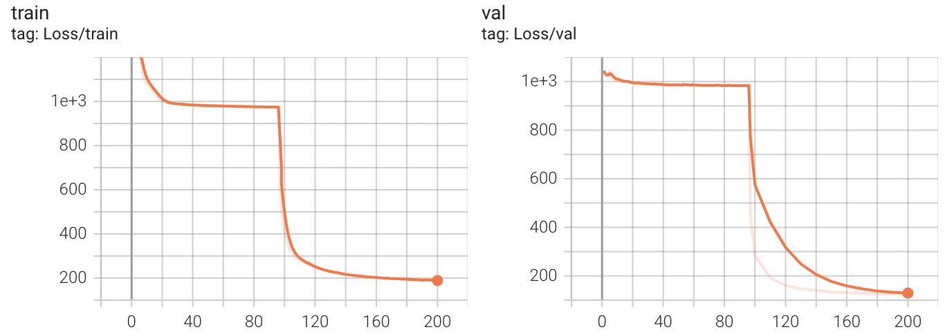
Initial Model Design & Training – BERT for Location
Fall 2024 – AI Practicum
Foundation Model: Simplified BERT Model (HuggingFace)
Location Model: Convert Vector to Location
Training Result
Fine-Tune 96 epochs
Accuracy: Avg 974km
Future Work
More complex Model
Additional Information
FC (768, 128)
Relu
Tokenizer
FC (128, 64)
Foundation Model
BERT
Model
Relu
FC (128, 64)
(Batch, 768)
Relu
Our Model
Location
Model
FC (64, 2)
Adding state information to the input significantly improves accuracy. Accuracy improvement is limited with tweet text alone; additional information is needed for Location Prediction.
(Batch, 2)

Slide 20
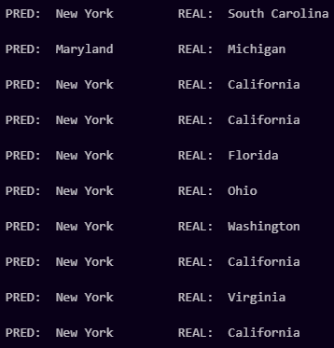
Initial Model Design & Training – BERT State
Fall 2024 – AI Practicum
Foundation Model: BERT Model (HuggingFace)
Location Model: Convert Vector to State
Training Result
Accuracy: 30%
Very time cost train: 1epoch per hour
Suspected to be overfitting since 1/3 of all data is from New York
Future work
Use ARC for more GPU power
Truncate the data
Tokenizer
Foundation Model
BERT
Model
(Batch, 768)
Our Model
Location
Model
(Batch, 50)

Slide 21
Initial Model Design & Training – LLM Approach
Fall 2024 – AI Practicum
Foundation Model: LLM Model with LoRA
Progress
Failed to get permission for LLMA weight Access
not feasible due to the high number of GPUs required
LLM Model
(GPT, LLMA)
Foundation Model
Fine-Tuning with LoRa
(Batch, Location Text)

Slide 22
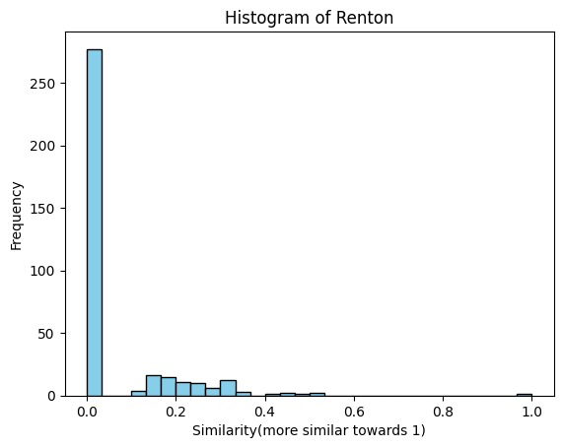
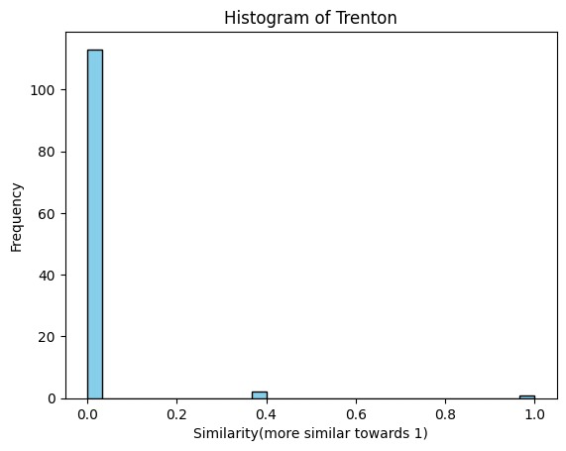
Initial Model Design & Training – Cluster Approach
Fall 2024 – AI Practicum
Vectorized tweet(text) Clustering
Progress
create vector of text tokens which are 500 dimensions vector
we can clearly see not that much similarity there for same city so we can not make cluster
Vectorized
Model

Slide 23
Additional Feature – Sentiment Analysis
Fall 2024 – AI Practicum
Foundation Model: VADER-Sentiment-Analysis
Tokenizer
VADER
Model
(Batch, 3)
'neg': Negative sentiment score
'neu': Neutral sentiment score
'pos': Positive sentiment score
Conclusion : In small text, it is difficult to determine joy, surprise, shock, angry or any other specific emotion. So Vader worked well in this context. Bert would be better if there are larger texts with more contexts.

